Slide 1
Robotics
Daniel Vasicek
2012/04/15

Slide 2
Topics for discussion
http://WWW.Udacity.com – Free College Classes
Robotics (Sebastian Thrun, ended April 9, 2012)
Computer Programming (Peter Norvig, April 16)
Computer Languages (Westley Weimer, April 16)
Sorting and Searching (Evans, Thrun, April 16)
Web Pages (Steve Huffman, Evans, April 16)
Cryptography (David Evans, April 16)
http://www.gotoif.org – Inquiry Facilitators
Teaching Math and Science

Slide 3
Robotics Class Organization
6 weeks of lectures, quizzes, and homework
1 week final exam
Grade based on homework and final or just final (if the final is higher than homework)
Homework was difficult
Final was easy
All programs written in Python

Slide 4
Course Syllabus
Week 1: Car localization with particle filters
Week 2: Tracking other cars with Kalman filters
Week 3: Image Processing and Machine Learning
Week 4: Planning and searching (A* and Dynamic Programming)
Week 5: Controlling steering and speeds with PID
Week 6: Programming a self-driving car
Week 7: Final Exam

Slide 5
Particle Filters
Use particles to capture the uncertainty in the position (state) of the robot
Two methods
Each particle has a known position. Instantiation of many particles characterizes the uncertainty
Kalman Method, each particle has a mean and variance
Sense and then Move
Both operations are uncertain
Use sensing to reduce the uncertainty
Motion increases the uncertainty

Slide 6
Motion Planning
Plan a path to the goal
Honor various constraints
Control speed, and orientation to achieve the goal
Minimize “cost”
A* algorithm for computational efficiency
Dynamic Programming for cost optimization

Slide 7
Robot Motion
Continuous versus discrete motion
Real motion is continuous
Our models are discrete
Smoothing the discrete paths to obtain “real” paths (Tichinov Regularization)
Control Theory
Proportional controller
Differential control to reduce oscillation
Bias reduction using an integration controller
Optimization of control parameters via search

Slide 8
Simultaneous Localization and Mapping
Graph SLAM
Create a map and find the location of the robot on the map
Make measurements on landmarks
Measurements are probabilistic constraints on the positions of the landmarks
E. G. x1=x0+1
Select the “most likely” values for x0, x1, …
Assume constant varience
Then, minimize the sum of things like (x1-x0-1)²

Slide 9
Graph SLAM
Minimize the sum of the square deviations:
S= (x1-x0-1)²+ •••
½ ∂S/∂x0 = x0 –x1 +1 + ••• = 0
½ ∂S/∂x1 = x1 –x0 -1 + ••• = 0
This is a giant linear system of equations for the unknown positions x0, x1, …
Every measurement linking the i and j positions will have the form of (x_{i} –x_{j} +b_{ij})²
The linear system will have the form
A*x = b

Slide 10
Graph SLAM
The A matrix of the graph SLAM can be built up by adding two terms corresponding to
x_{j} –x_{k} +b_{jk} =0
x_{k} –x_{j} –b_{ik} =0
Into the system of equations for each constraint
This forms a symmetric sparse set of equations that gives the maximum likelihood values for the unknown positions under the assumption of uniform variance Gaussian noise

Slide 11
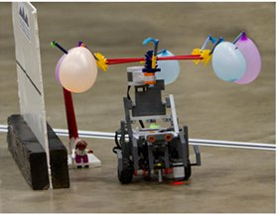
www.gotoif.org
Use robots to motivate students to learn mathematical and statistical concepts
RoboRave May 5, 2012
Albuquerque Convention Center
2-4 k-12 grade students
Solve problems using 100% autonomous robots
Follow a line
Put out a fire
Go fast from A to B

Slide 12
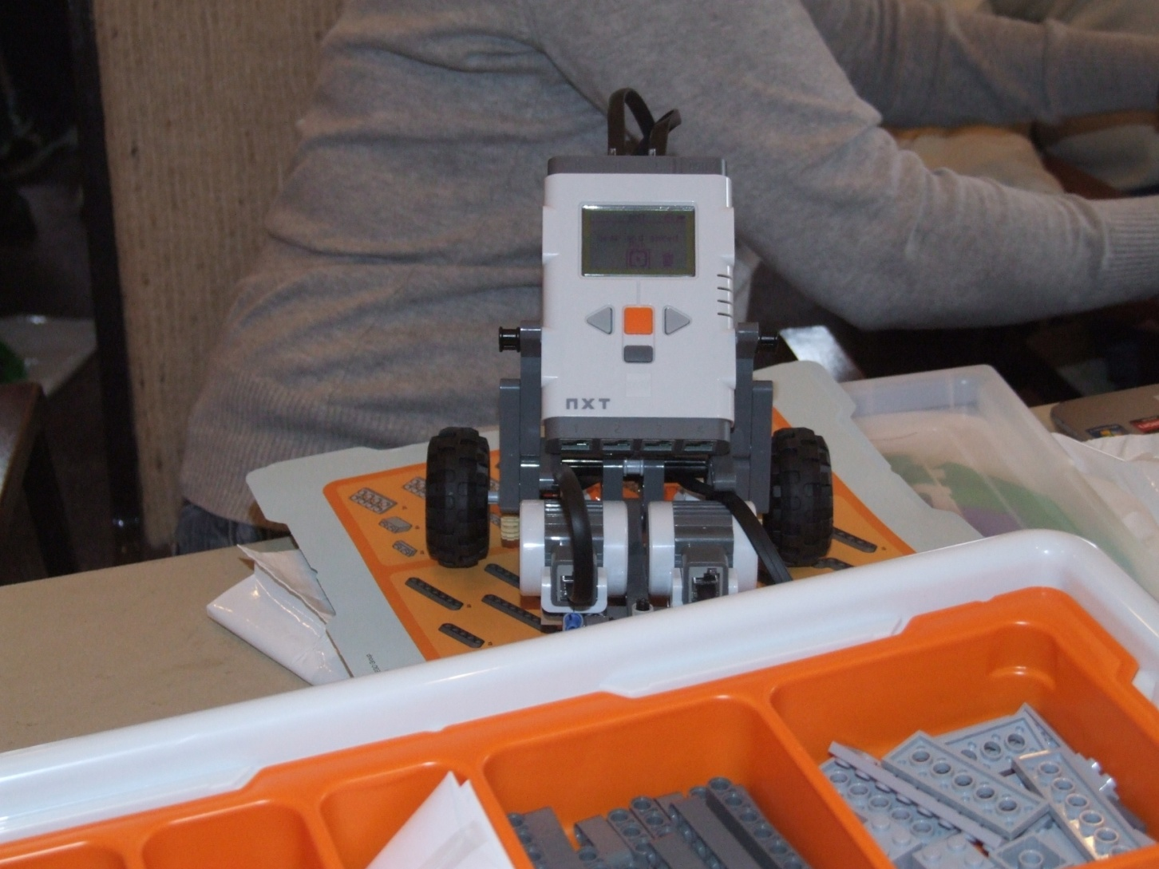
Lego Robot “kit” $350

